Slide 1


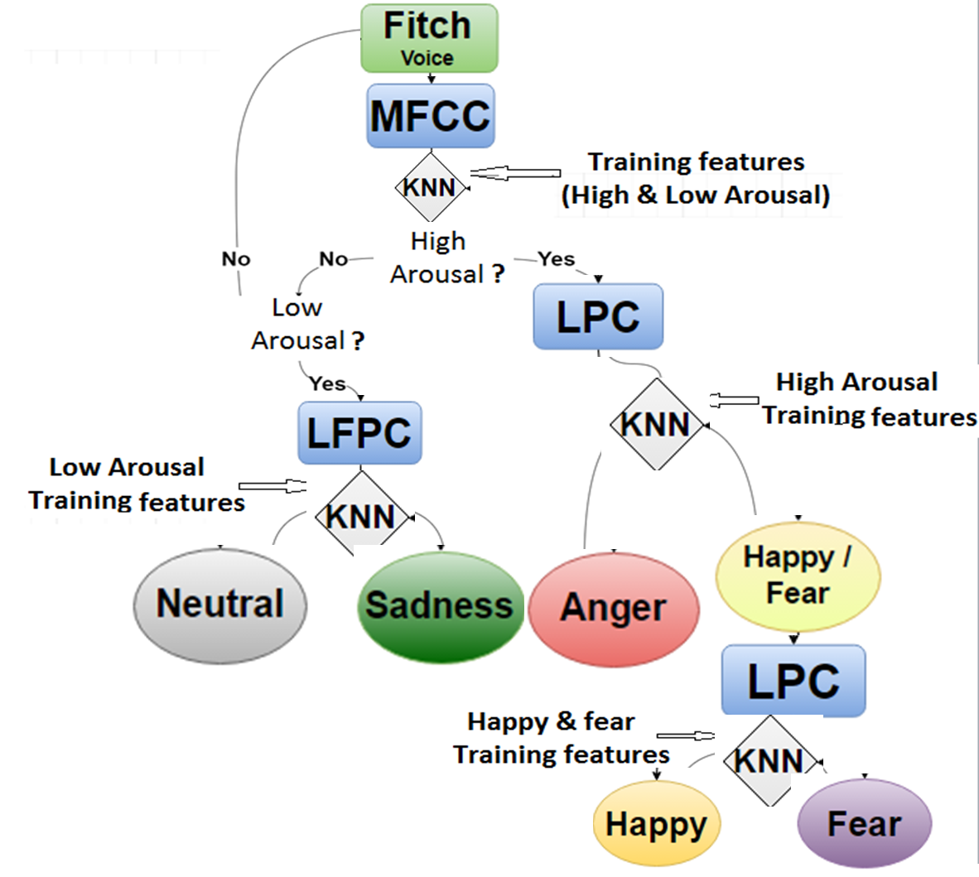
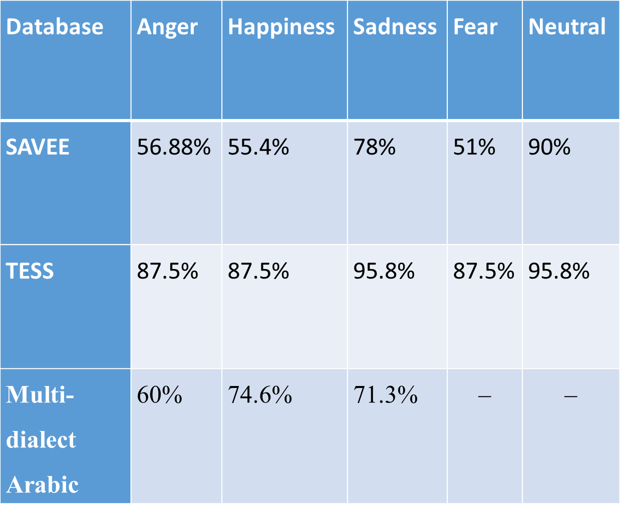
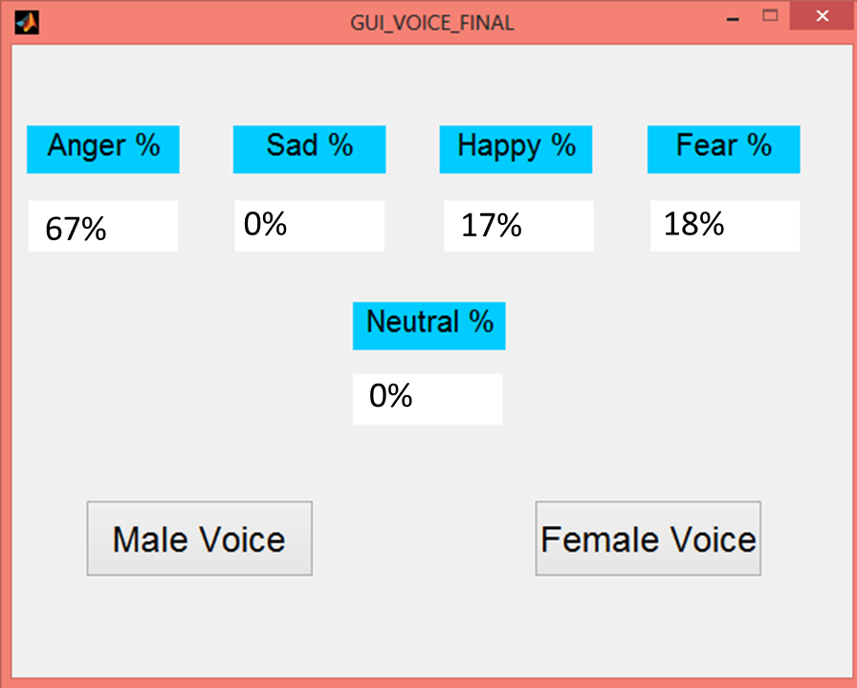
Fatima Fouda 121649
Yosif Atef 120723
ECE 2015-16
Real time Speech Emotion Recognition for Archetypal Emotions
Aims and Objectives:-
The primary aim of this project is to:
Design a low computationally complicated, highly accurate ASER system to identify seven states of emotion: anger, joy, disgust, fear, sadness, surprise, and neutral, for real time applications
Compile an Arabic database, to achieve a bilingual system
Translate the system into a desktop application
Background:-
Fig 1: Binary decision tree
Speech emotion recognition is in high demand due to its vital role in affective computing which plays major roles both in Human-Computer interaction (HCI) as well as human-human interaction.
Current systems can be distinguished from one another by three defining aspects:
  database used
  features extracted
  type of classifier
Most speech emotion systems have attempted to find the most effective algorithm, by manipulating any or all of these previously stated aspects in order to achieve higher accuracy.
Methods:-
The two methodologies used are: speech processing, and machine learning.
The extracted features are: MFCC, LPC, and LFPC.
The type of the used classifier is: Modified K-NN
The technology used for testing is: MATLAB & Python
The speech emotion database used is: SAVEE & TESS& constructed Arabic Database
Table 1: Comparison of different Systems’ accuracy rates for SAVEE database
System | Extracted Features | Accuracy
SVM + Binary Decision Tree | Human auditory model | 73.81%
Multiclass SVM | MFCC ZCR Energy Short-term energy Spectral roll-off | 98.3%
Proposed System KNN + Binarry Decision Tree | MFCC LPC LFPC | 90.2%
Results:-
The KNN classifier was modified to improve the accuracy that achieved 95%, whereas the conventional KNN accuracy achieved 67%. ( should discuss with you)
Many papers have utilized SAVEE database to test their ASER systems. Table 1 outlines a comparison between two such systems against the proposed system.
A desktop application with a user-friendly UI was designed as illustrated in Figure 2 ( swap it with Table 2)
Table 2 breaks down the accuracy rates achieved by the proposed ASER.
Table 2: Accuracy breakdown ( increase the font size)
Conclusions
LFPC differentiates between two low arousal emotions (Sadness/neutral)
LPC differentiates among three high arousal emotions (Anger/Happy/Fear).
5 emotions and silence are recognized.
Conventional KNN design yields an accuracy of 54-56%. Modifications to the KNN achieved a much higher accuracy rate up to 95.8%.
The cost of the system is insignificant since it is a desktop application.
Fig 2: System GUI (after Table 2)

